Slide 1
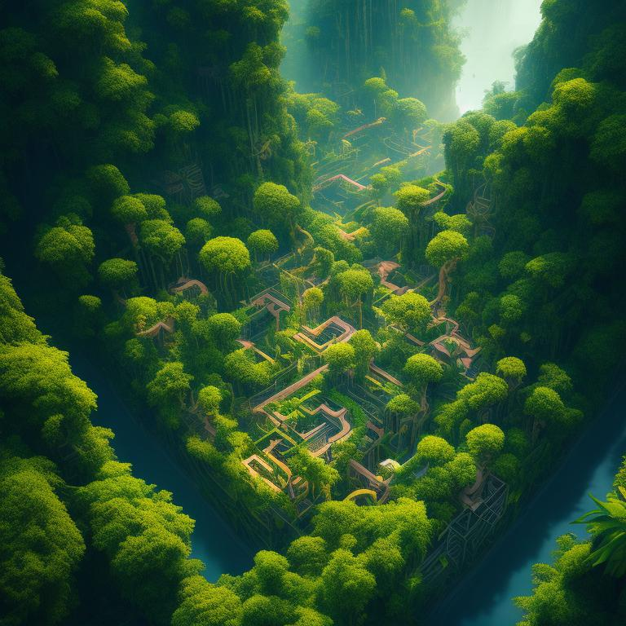
THE
JUNGLE
MAZE
RUNTIME TERRORS
Game Concept
“The Jungle Maze" is an exciting and educational maze-solving game to be designed for kids. Players take on the role of a brave adventurer who finds themselves trapped in a jungle maze filled with wild animals. The objective is to navigate through the maze, collect keys to unlock the exit door, and escape without getting caught by the roaming wildlife.

Slide 2
THE
JUNGLE
MAZE
RUNTIME TERRORS
Game Concept
“The Jungle Maze" is an exciting and educational maze-solving game to be designed for kids. Players take on the role of a brave adventurer who finds themselves trapped in a jungle maze filled with wild animals. The objective is to navigate through the maze, collect keys to unlock the exit door, and escape without getting caught by the roaming wildlife.

Slide 3
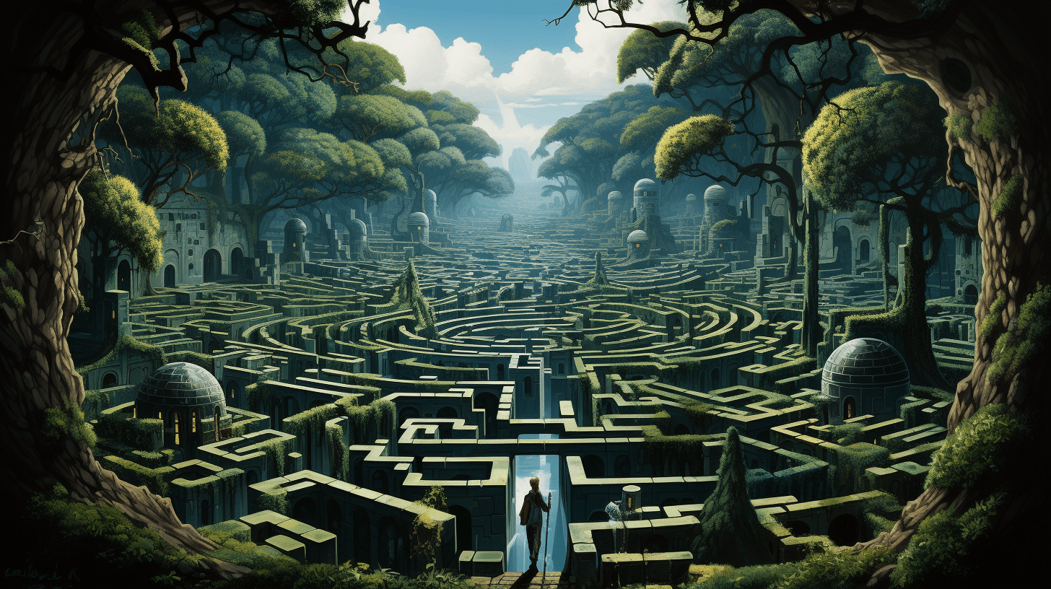
Why we chose this?
Experience the thrill of navigating mazes, avoiding wild animals, and collecting keys to escape.
The game not only provides entertainment but also offers valuable educational content, aligning with our goal to create games that are both engaging and enriching for players.
Encourages problem-solving, critical thinking, and strategic planning skills.

Slide 4
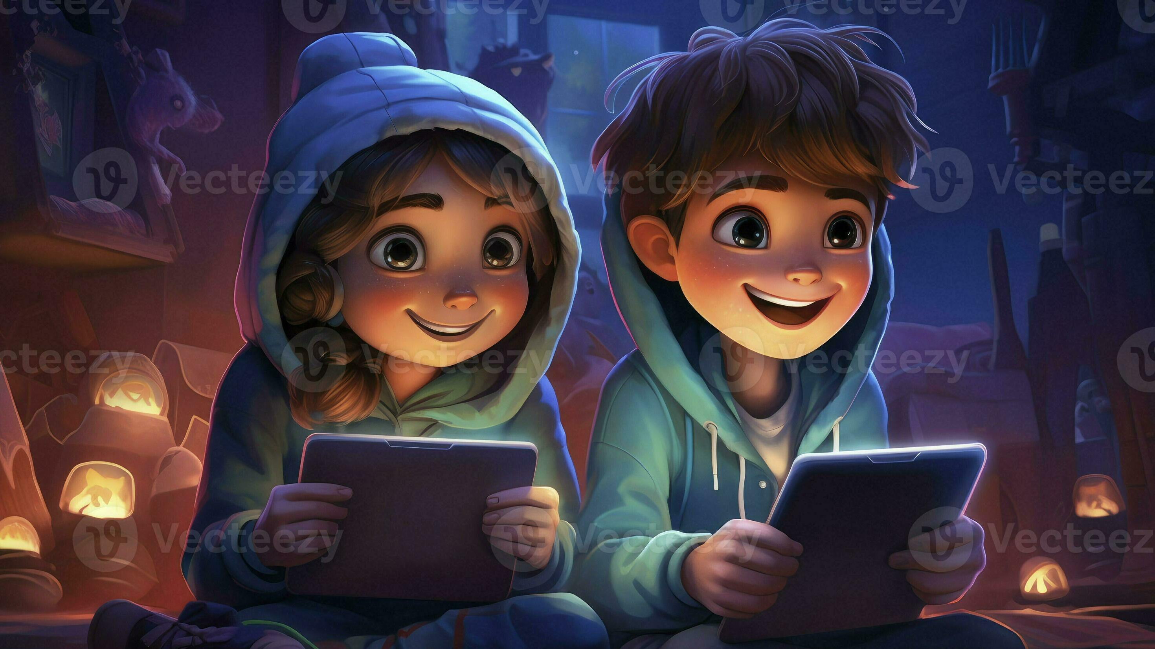
Target Audience
Our target audience for the “The Jungle Maze" game primarily includes children aged 8 to 12, as well as casual gamers and families.
Children in this age group are at a stage where they are curious, eager to learn, and receptive to new concepts.
By targeting families, we aim to create a game that can be enjoyed together, promoting bonding and shared experiences.

Slide 5

Team Formation
Game Designer
Responsible for designing the overall gameplay mechanics, level layouts, and puzzle challenges.
Programmer
Develops the game mechanics, implements features, and ensures smooth functionality.
QA Tester
Conducts thorough testing and quality assurance to identify bugs, glitches, and gameplay issues.
Project Manager
Oversees the project timeline, task allocation, and coordination among team members.

Slide 6

Required Resources
Computers or laptops for development and testing purposes.
Python IDE (Integrated Development Environment) for programming game logic and mechanics using Python language.
Graphic design software (e.g., Adobe Photoshop, Illustrator, GIMP) for creating visual assets, characters, environments, and UI elements.

Slide 7

Future Aspects
We can expand the game by adding new maze themes, challenges, and levels to keep players engaged and excited.
In the future, we aim to introduce multiplayer functionality, allowing players to compete or collaborate with friends and family members.
To reach a wider audience, we plan to optimize the game for mobile devices, making it accessible to players on smartphones and tablets.

Slide 8
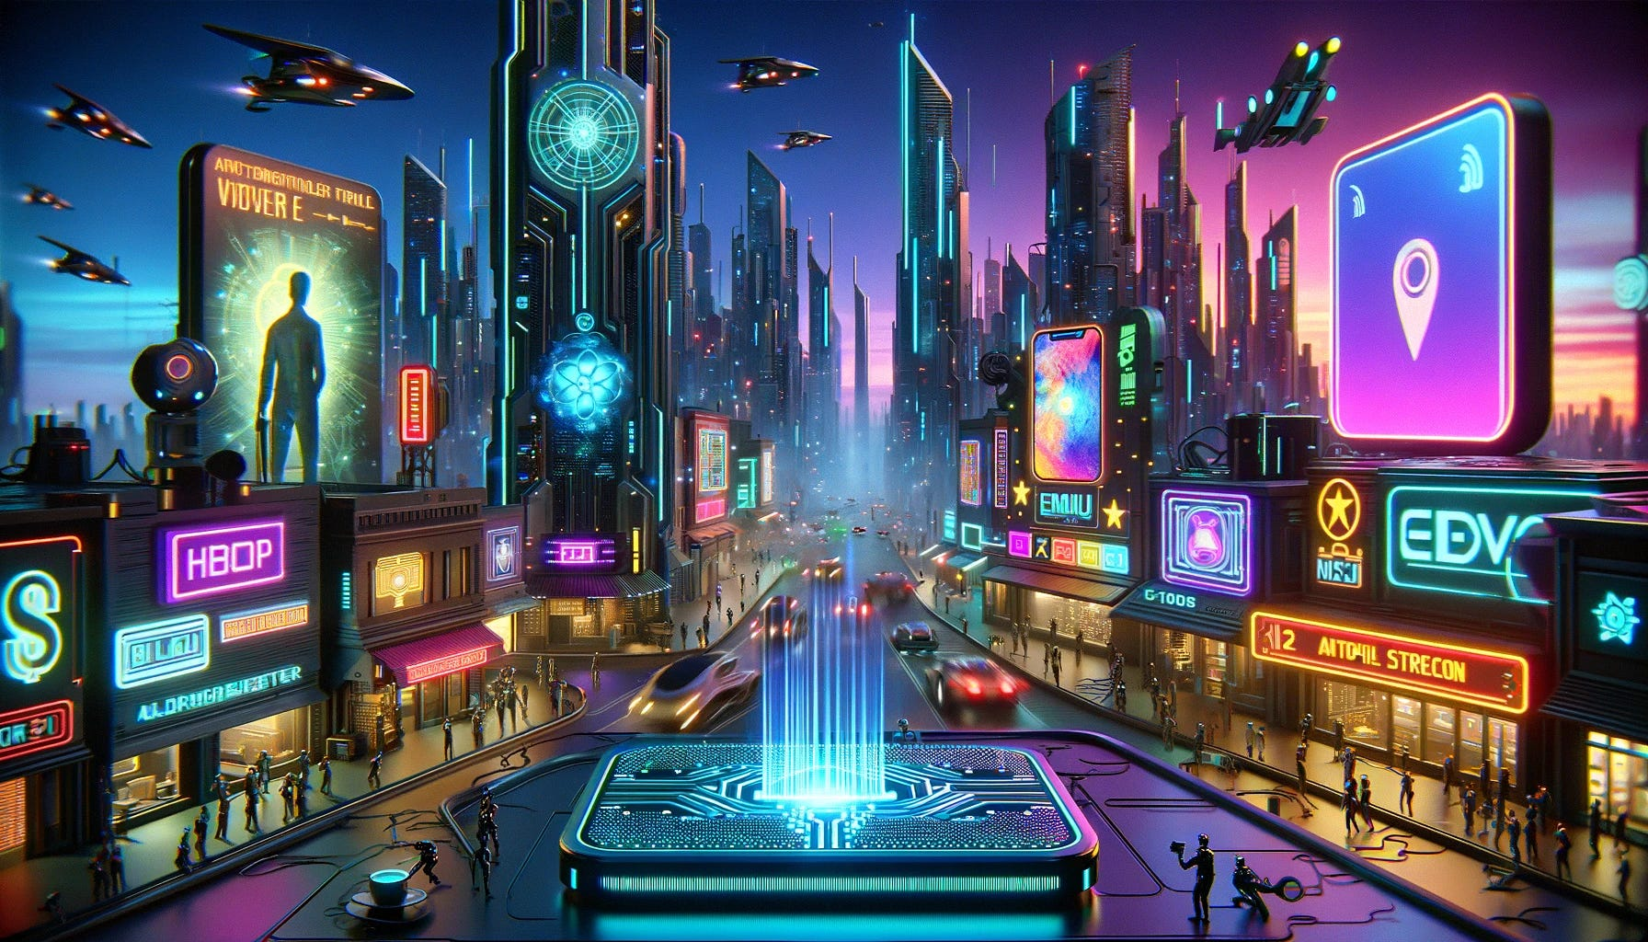
Conclusion
In conclusion, “The Jungle Maze" is an innovative and engaging game concept that combines the thrill of maze-solving with educational elements about wildlife, problem-solving, and critical thinking. With a dedicated team and the necessary resources in place, we are confident in our ability to bring this game to life and achieve our future goals.

Slide 9
THANK
YOU
Game Concept
“The Jungle Maze" is an exciting and educational maze-solving game to be designed for kids. Players take on the role of a brave adventurer who finds themselves trapped in a jungle maze filled with wild animals. The objective is to navigate through the maze, collect keys to unlock the exit door, and escape without getting caught by the roaming wildlife.

